Slide 1

WWW.CHEMSHEETS.CO.UK
REACTING MASS CALCULATIONS
© www.chemsheets.co.uk GCSE 1116 24-Dec-2016

Slide 2
REACTING MASS CALCULATIONS
The first step in solving a problem is always to identify the information and quantities you are given and the ones you are required to calculate.
In Stoichiometry, you should first check the equation in BALANCED as part of determining what information you have been given.
SYMBOLS USED in these answers:
GIven quantity
Required Quantity
✔
?
© www.chemsheets.co.uk GCSE 1116 24-Dec-2016

Slide 3
REACTING MASS CALCULATIONS (Examples)
What mass of oxygen reacts with 12 g of magnesium?
2Mg + O₂ → 2MgO
✔
?
Moles Mg = mass
MM
= 12g
24g/mol
= 0.5
Moles O₂
= 0.25 mol
Mass O₂ = MM x moles
= 32g/mol x 0.25mol
= 8 g
© www.chemsheets.co.uk GCSE 1116 24-Dec-2016

Slide 4
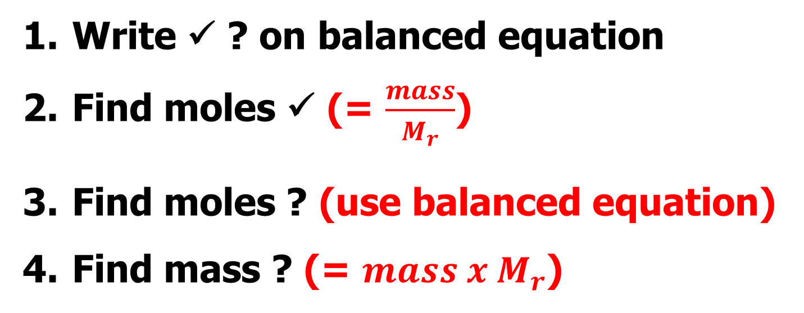
REACTING MASS CALCULATIONS
MM
MM
© www.chemsheets.co.uk GCSE 1116 24-Dec-2016

Slide 5
REACTING MASS CALCULATIONS (Examples)
2) What mass of calcium hydroxide is made from 14 kg of calcium oxide?
CaO + H₂O → Ca(OH)₂
✔
?
NOTICE how units cancel out to leave you with the desired unit. This is a good mental check!!!
Moles CaO = mass
MM
= 14000 g
56g/mol
= 250 mol
Moles Ca(OH)₂
= 250mol
It is an expectation that equations will be solved on multiple lines with the = signs lined up as per this equation. For fitting solutions on the slides some are solved horizontally, though
Mass Ca(OH)₂ = MM x moles
= 74g/mol x 250mol
= 18500 g
© www.chemsheets.co.uk GCSE 1116 24-Dec-2016

Slide 6
REACTING MASS CALCULATIONS (Examples)
3) What mass of aluminium is needed to react with 640 g of iron oxide?
Fe₂O₃ + 2 Al → 2 Fe + Al₂O₃
✔
?
Moles Fe₂O₃ = mass
MM
= 640g
160g/mol
= 4mol
Moles Al
= nFe₂O₃ x molar ratio
= 4mol x 2
1
= 8mol
Mass Al = MM x moles
= 27g/mol x 8mol
= 216 g
© www.chemsheets.co.uk GCSE 1116 24-Dec-2016

Slide 7
REACTING MASS CALCULATIONS (Examples)
4) What mass of titanium chloride reacts with 460 g of sodium?
TiCl₄ + 4 Na → Ti + 4 NaCl
?
✔
Moles Na = mass
MM
= 460
23
= 20
Moles TiCl₄
= 5
Mass TiCl₄ = MM x moles
= 190 x 5
= 950 g
The numbers and solutions are all correct on this slide. WHAT IS MISSING IN THE SOLUTIONS?? HInt: what should be after the numbers in each equation?
© www.chemsheets.co.uk GCSE 1116 24-Dec-2016

